Slide 1

WeatherGuardian AI: An Agentic and Service-Oriented Framework for Intelligent Weather Advisory Management
SOA Project Review-3
September 16th, 2026
 | Under the Guidance of Dr. Srikanth Cherukuvada Assistant Professor, Department of Computer Science and Engineering, KLH CSE Bowrampet Campus
Team Members M.Sai Sahasra – 2420030706 Abhilash Reddy – 2420030595 Ch.Lucky Redyy– 2420030739

Slide 2
Outline of Research Work
Focus
Introduction
Literature Survey
Challenges
Research Objectives
Conclusion & Future Work
References
Publications Details

Slide 3
Problem Statement
Existing weather applications mainly provide raw weather information such as temperature, humidity, rainfall, wind speed, and forecasts, but they often require users to interpret this information themselves. They may also lack an integrated mechanism for analyzing weather conditions, identifying potential risks, and providing personalized and timely advisories. Furthermore, tightly coupled weather applications can be difficult to maintain, scale, and integrate with external services. Therefore, there is a need for an intelligent and flexible weather advisory system that can collect real-time weather data, analyze potential risks, generate meaningful recommendations, and deliver timely alerts. The proposed WeatherGuardian AI addresses this problem by using a Service-Oriented Architecture (SOA) consisting of independent and reusable services that communicate through APIs, while an AI-based advisory service converts analyzed weather information into actionable recommendations.

Slide 4
Innovation, Creativity, and Novelty
🔹 Innovation:
The system uses AI to convert real-time weather data into meaningful and actionable recommendations.
It automatically detects potential weather risks such as heavy rainfall, extreme heat, and strong winds.
It monitors changing weather conditions and updates advisories in real time.
🔹 Creativity:
The system provides personalized weather recommendations based on weather conditions and user context.
It delivers simple and user-friendly alerts to help users understand potential risks.
🔹 Novelty:
The system incorporates agentic AI to support adaptive decision-making and automatic advisory updates.

Slide 5
Feasibility
1. Technical Feasibility:
The system can be developed using Python, AI/ML techniques, weather APIs, and RESTful services.
Real-time weather data can be collected from external weather APIs.
The dashboard can be developed using React or Streamlit.
SOA can be implemented using independent services for scalability and maintainability.
2. Economic Feasibility:
The project can be developed using open-source tools and libraries.
Weather APIs may provide free or developer-level access.
No expensive hardware is required for basic implementation.
3. Operational Feasibility:
The system provides a simple and user-friendly dashboard.
It automatically analyzes weather conditions and generates advisories.
It can support daily activities, travel planning, agriculture, and weather safety awareness.

Slide 6
Project Plan
Phase | Major Activities | Timeline
Phase 1 | Literature survey, problem identification & requirements | Week 1–2
Phase 2 | SOA architecture and system design | Week 3
Phase 3 | Weather dataset preparation and data collection using weather APIs | Week 4–5
Phase 4 | Weather risk analysis and advisory generation model development | Week 6–7
Phase 5 | AI advisory mechanism and adaptive agent development | Week 8–9
Phase 6 | Real-time weather risk monitoring and advisory optimization | Week 10
Phase 7 | SOA service integration and REST API development | Week 11
Phase 8 | Dashboard and visualization development | Week 12
Phase 9 | Testing, comparison and performance evaluation | Week 13–14
Phase 10 | Documentation, results and final presentation | Week 15

Slide 7
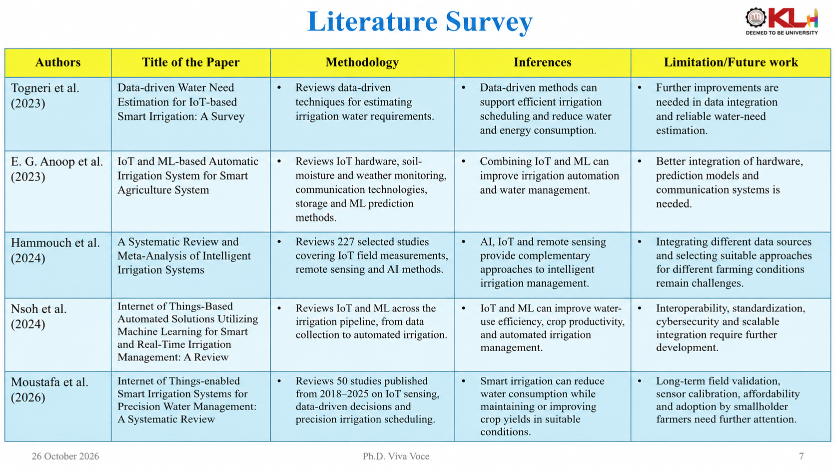
Literature Survey

Slide 8
Research Gap Identification
Gap 1 — Prediction vs Advisory
Existing systems mainly focus on predicting weather, rather than telling users what they should do.
Gap 2 — Personalization
There is limited focus on providing personalized recommendations based on user location and weather conditions.
Gap 3 — Agentic AI
There is limited use of agentic AI for automatic risk analysis and decision-making.
Gap 4 — Integration
Weather prediction, alerts, and user communication are often handled as separate functions.
Gap 5 — Actionable Information
There is a need for an integrated system that provides:
Real-time + Explainable + Actionable Weather Advisories

Slide 9
Objectives
To develop an intelligent irrigation management system using Service-Oriented Architecture (SOA).
To collect and process soil, weather, and crop-related data for irrigation planning.
To develop an ML-based model to predict irrigation requirements.
To implement AI agents for soil, weather, crop, and carbon analysis.
To optimize irrigation schedules by considering water requirements and carbon emissions.
To integrate independent services using RESTful APIs for efficient communication.
To develop a user-friendly dashboard for monitoring irrigation recommendations and system performance.

Slide 10

Significance/Outcomes
1. Improved Weather Awareness: WeatherGuardian AI provides real-time weather information and meaningful recommendations to help users understand changing weather conditions.
- The system converts raw weather data into useful and actionable information.
2. Early Weather Risk Detection: The system identifies potential weather hazards such as heavy rainfall, thunderstorms, extreme heat, and strong winds.
- It helps users recognize potential risks and take preventive measures.
3. Intelligent Weather Advisories: The AI Advisory Service generates suitable recommendations based on analyzed weather conditions.
4. Timely Alerts and Notifications: The Notification Service delivers alerts when critical weather conditions are detected.
- It helps users stay informed about potentially hazardous weather conditions.
5. Adaptive Weather Monitoring: The system responds to changing weather conditions and updates recommendations accordingly.
- It supports timely and adaptive weather advisory management.

Slide 11
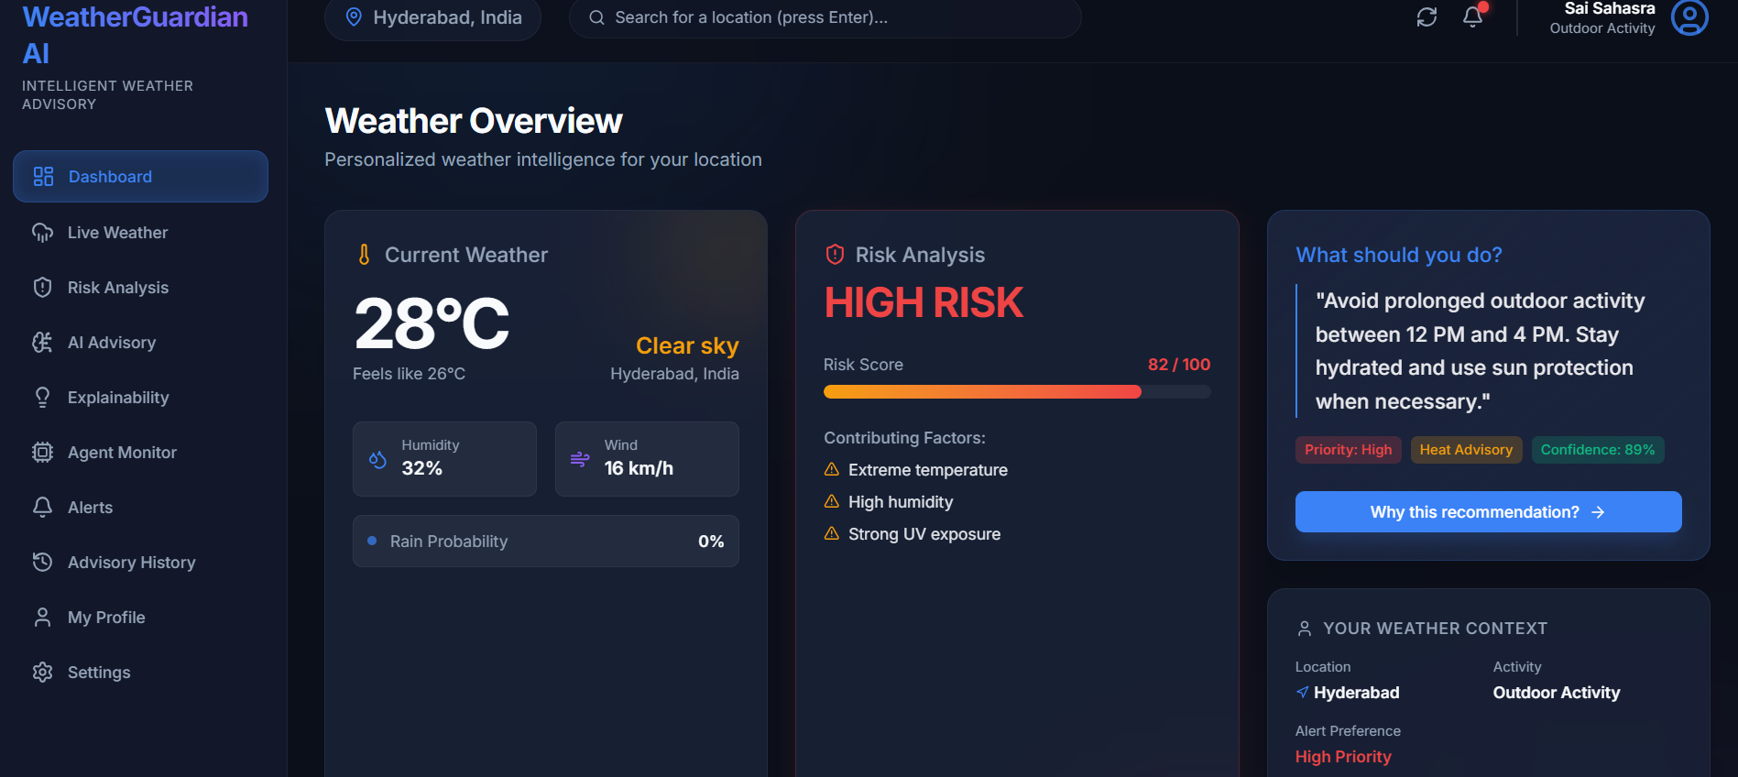
IMPLEMENTATION

Slide 12
